Slide 1
Cyber Cypher - Advanced Level Team 4 - Bit By Bit

Slide 2
TABLE OF CONTENTS
01
02
Project Goal
Project Description
03
Sneak Peak

Slide 3
Project Goal
Stock market prediction is the act of trying to determine the future value of a company stock or other financial instrument traded on an exchange. The successful prediction of a stock’s future price could yield significant profit. This approach focuses on how can NLP be used by traders, investors, and financial analysts to get the most out of textual, numerical and sentiment analysis.

Slide 4
Approach 1
Used historical stock data and sentiment analysis to predict average and closing price for the next day
Took historical Sensex data from BSE.
Took headlines from Times of India dataset without labels.
Mapped and concatenated publish date of headlines to stock data.
Converted headlines into two features: polarity and subjectivity using text blob.
Trained a RandomForrestRegressor on the above data.

Slide 5
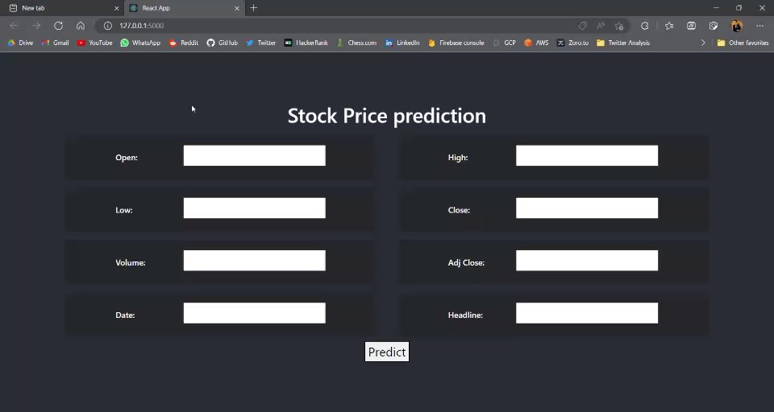
Sneak Peak

Slide 6
Approach 2
We need to work on both, textual data and numerical data.
Took top 25 news headline from 2008-2016.
EDA (Padlen=1400, vocab=22363)
Remove patterns
Lemmatization
Remove stopwords
Convert to vectors using FastText word embedding
Took matching datetime Microsoft Stock data.
Data normalization
Multi-input deep learning model

Slide 7
Thank-You

